Slide 1

Revolutionizing Traffic Flow - Using Traffic Signal Performance Measures without Traditional Detection Methods
Steve Remias
Steve.Remias@INRIX.com
Notes:
Introduce Yourself
Today were going to talk a problem that most everyone experiences and contributes to, but very little realize they do.

Slide 2
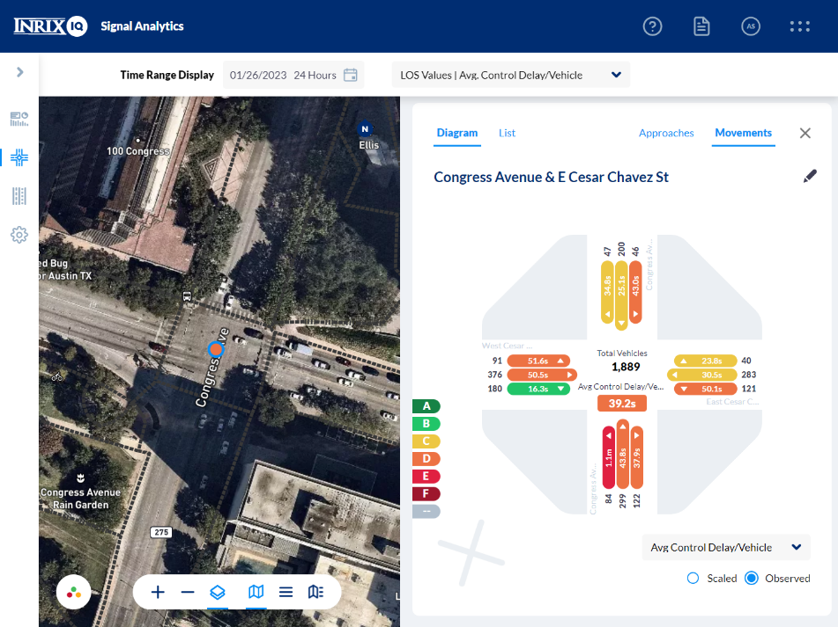
Agenda
Why Are Signal Performance Measures (SPMs) Important?
Overview & Contrast Controller/Sensor-Based SPMs and GPS-Based SPMs
Use Cases
Notes:
Session Goals are to:
Develop a Base-Level Understanding of SPMs
How to Get Started with SPMs – controller-based and/or GPS-based
Share Example Agency Story around both sensor based and GPS based SPMs

Slide 3

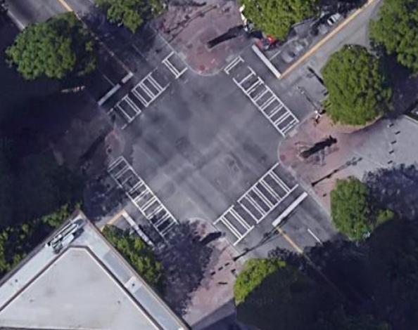

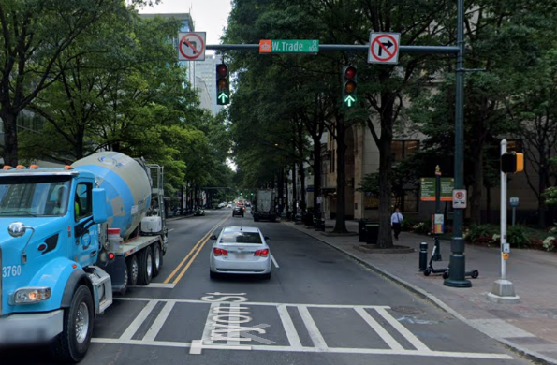
The Opportunity
Poorly Timed Traffic Signals are Difficult to Manage
How Would We Know?
Wait for a phone call
Scheduled signal retiming
What Could We Do?
Install detection infrastructure
Manual data collection
Model with software
Hire a consultant
Why Should We Care?
Delay
> 330 mil. vehicle hours of delay per year at signals
Fuel Use
6 to 9% fuel savings at well timed signals
Emissions
1 gallon of fuel = ~20 pounds of CO2
Safety
Better managed signals = safer signals
Notes:
Poorly Timed Traffic Signals
Let’s consider this urban signal in Charlotte (click)
A pretty standard 4 legged intersection (click) in a downtown urban core (click)
If there were a problem at this intersection, how would we know? (click)
If we knew about the problem, What could we do? (click)
Why should we care (click)
Read and elaborate on stats (click)

Slide 4

These Solutions Don’t Scale
The Solution
One intersection is easy. An entire network…..
Use Data from Vehicles
Notes:
An engineer managing one signal is relatively easy. Perform a traffic study, retime the signal, observe the benefits (click)
An engineer managing an entire network of signals becomes more difficult, time consuming, and expensive.
How can I identify the signals I should be prioritizing (click)
Our solution is leveraging the vehicles with in-dash GPS devices to give us an idea of how signalized intersections are performing (click)
As vehicles move through the network when they pass through a signalized intersection we can leverage those waypoints to tell us how an intersection is performing (click)

Slide 5

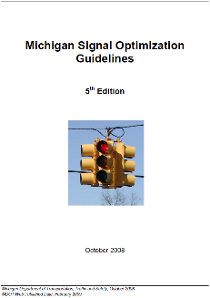
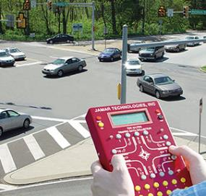
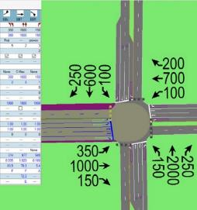
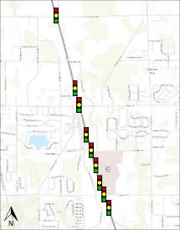



Current Practice
Develop Guidelines
Hire Consultant
Data Collection
Modeling
Implement
Results
Source: jamartech.com
Source: trafficware.com
How do we know how well we did?
How do we know where we should do this?
How do we know if we collected the right data?

Slide 6
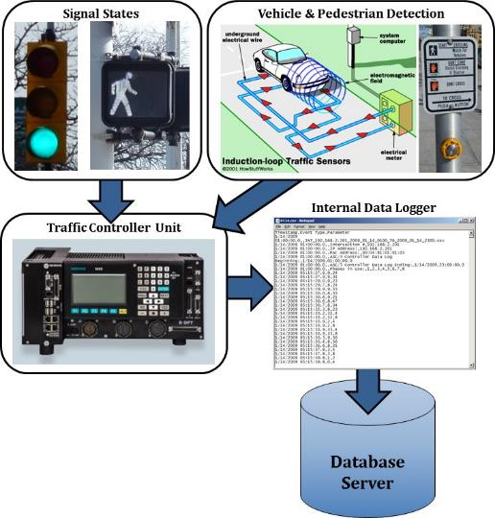

What are Automated Traffic Signal Performance Measures?
Detector-Based

Slide 7















What are Signal Performance Measures?
Observed metrics at a signalized intersection that can be used to measure agency objectives
Examples:
Travel Time
Turn Ratios
Phase Termination
Approach Speed
Split Failures
Yellow/Red Actuations
Control Delay
Stops / AOG
Splits
Level of Service
Coordination
Left Turn Gap Acceptance
Vehicle Counts
Pedestrian Delay
Preemption Count

Slide 8
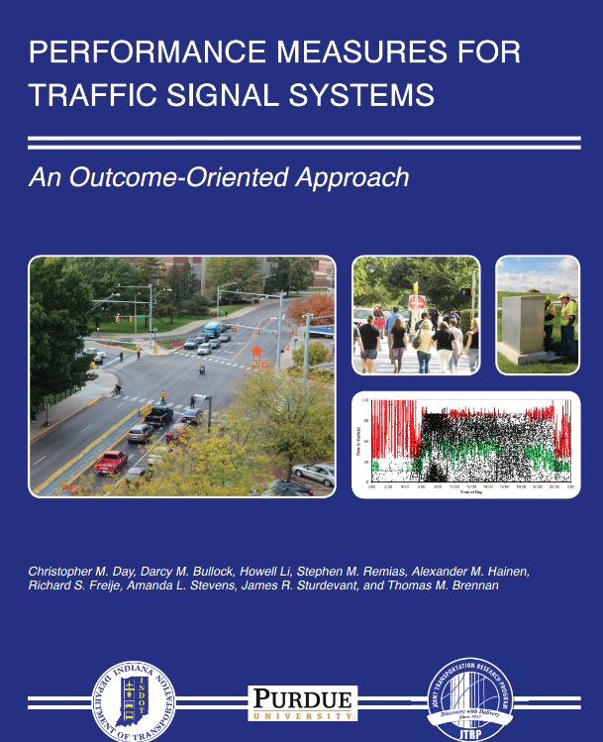
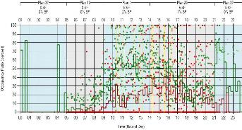
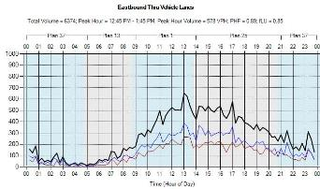
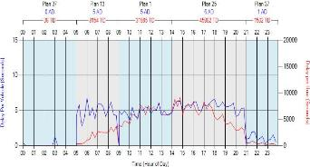
Performance Measures for Traffic Signal Systems
https://docs.lib.purdue.edu/cgi/viewcontent.cgi?article=1002&context=jtrpaffdocs
Purdue Coordination Diagram
Split Failure Monitor
Approach Delay
Volume
Notes:
Steve to add text and edit slide as desired.

Slide 9
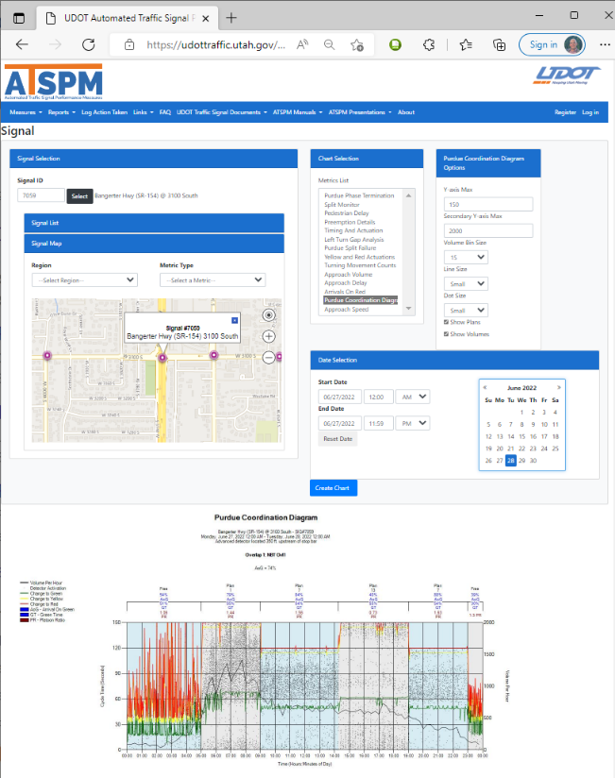
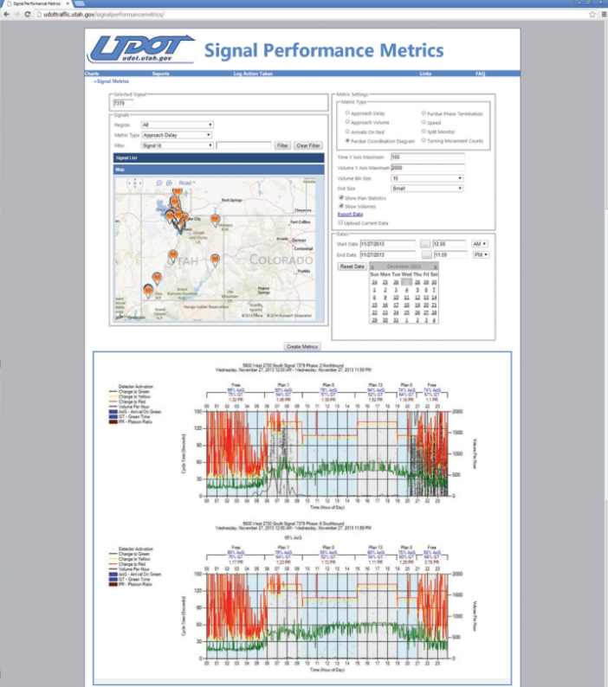
UDOT Open Source ATSPM Platform
https://udottraffic.utah.gov/ATSPM

Slide 10
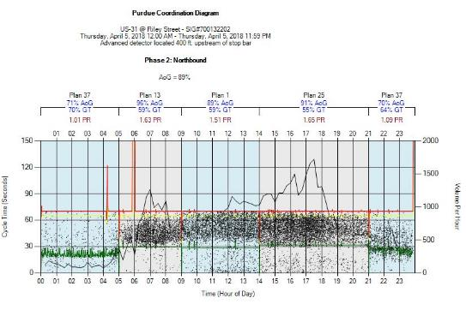
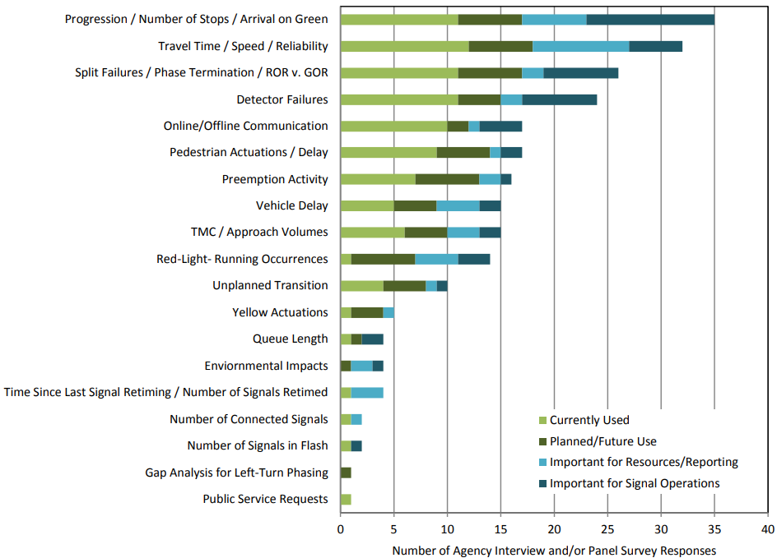
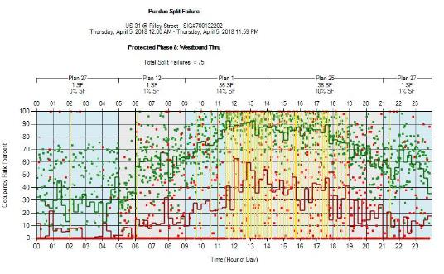
What are agencies using them for?
Source: Kittelson & Associates Inc. & Purdue University “NCHRP Project 03-122: Performance-Based Management of Traffic Signals” January 2017

Slide 11

Image: Chevy

Slide 12


GPS Based Signal Performance Measures
Departure
Metrics for each vehicle
Travel Time
Approach Speed
Vehicle Stop
Vehicle Double Stop
Movement (Left, Thru, Right)
DISTANCE
Arrival
TIME

Slide 13

The Metrics – Assumptions
42 sec
ARRIVAL ON GREEN
61 sec
ARRIVAL ON RED
100 sec
SPLIT FAILURE
1
2
3
DISTANCE
DISTANCE
DISTANCE
TIME
TIME
TIME

Slide 14
Developing the Metrics
5th Percentile
Reference Travel Time
Delay
80 m
Outbound Length
Distance
150m
Stop <6 mph
Inbound Length
Speed
Travel Time
NB
Time
14
14

Slide 15
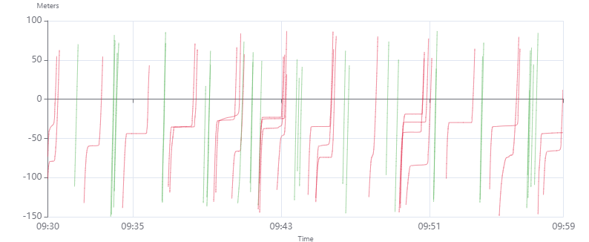
Real Trajectory Data

Slide 16
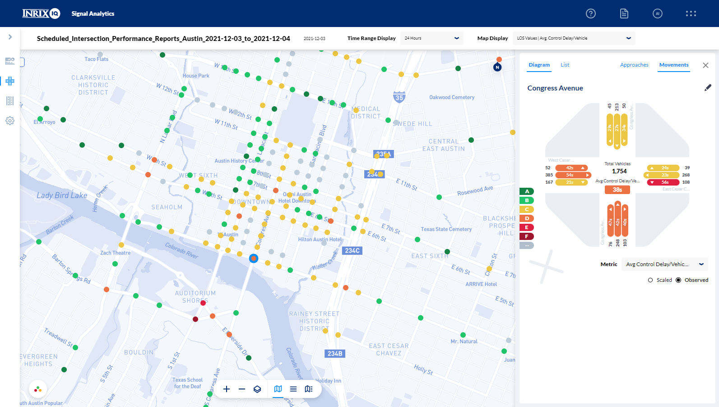







Derive Insights from the Vehicles Themselves
Signal Performance Metrics Available
Travel Time
Turn Ratios
Approach Speed
Vehicle Counts
DISTANCE
Control Delay
Split Failures
Level of Service
Stops / AOG
TIME
Notes:
From the waypoints we can derive performance measures like……
At every intersection, everywhere, all the time (click)
We aggregate all of those metrics into our product INRIX Signal Analytics
The product allows you to identify underperforming intersections, compare intersections before and after retiming projects, rank intersections based on any of the metrics and most importantly scale (click)

Slide 17
Notes:
INRIX Signal analytics can be turned on at any of the 240,000+ intersections currently available in the platform or any other intersection that is identified by an agency or DOT. (click)
The basis for this platform is a suite of cloud based services from Amazon Web Services.
The cloud allows billions of data points to be turned into actionable insights for agencies to save time, fuel, and reduce the emissions caused by poor traffic signal timings. (click)

Slide 18
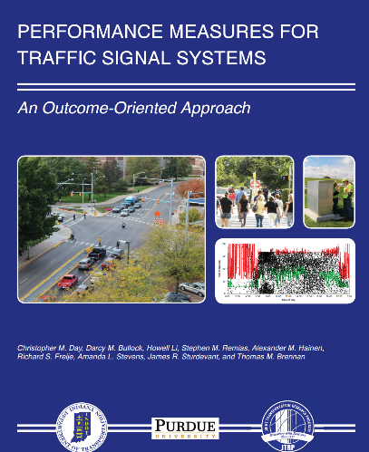
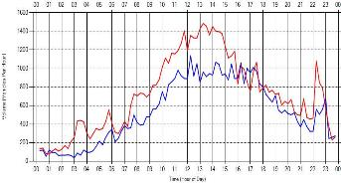
Sensor-Based / Detector-Based SPMs
Strengths
~100% of traffic
Includes signal timing information
Includes phase termination
Visualize detector actuations
Limitations
Complex detector layout
System-wide comparison difficult
Many points of failure
Some metrics are approximated
Notes:
Opportunities
All to nearly all traffic captured (depending on sensor/detector layout)
Direct measure of cycle length, splits, offsets, pedestrian/bike/transit/truck/EV phasing
Know phase termination... omit, skip, gap-out, max-out, force-off, coordination
See detector actuations (depending on sensor/detector layout)
Limitations
Relies on more complex detector/sensor layout & configuration
Inconsistencies in detector/sensor layout or functionality can make SPM eval/compare difficult or inaccurate
Introduces more points of failure
Approximates SPMs like AOG/AOR, Split Fails, Delay rather than directly measuring

Slide 19

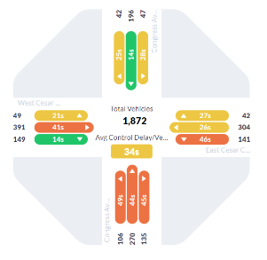
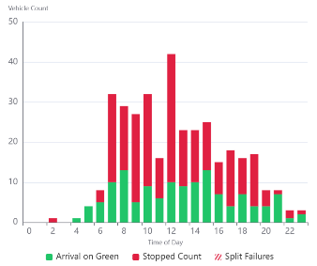
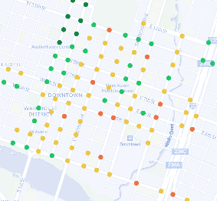
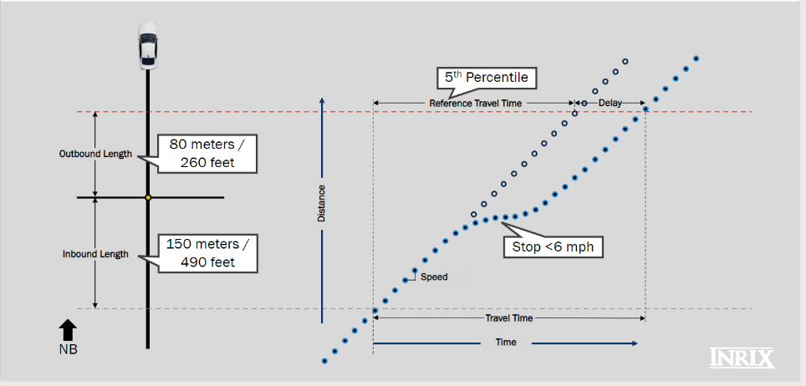
GPS, Trajectory-Based SPMs
Strengths
Real ‘observed’ vehicles
No added infrastructure
Scale & Consistency
Integrated Software
Limitations
Only a sample of vehicles
No direct signal/phasing measurement
Vehicle only
Not in real time
Notes:
Opportunities
Real Road User Trajectories --> Accurate SPMs
GPS-vehicle to cloud --> No agency infrastructure or extra components to purchase/maintain
Integrated SPM analytics calculation software --> easy, simple SPM analysis
Easy to scale to network level for agency-wide relative comparisons
Probe sample size is increasing exponentially
Historical Data back to January 2020 (INRIX Signal Analytics)
Limitations
Is based on probe data --> only a sample of conditions
No direct signal phasing/timing measurement
Vehicle only, currently

Slide 20

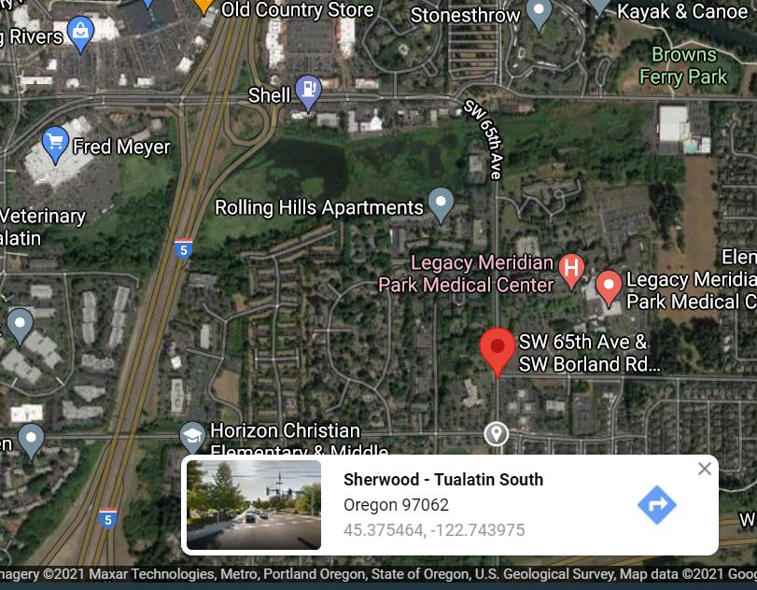
Use Case - Washington County – Customer Complaint Response
Customer Complaint
“Around 4pm major back-ups on 65th near Meridian Park Hospital… takes me longer to get from I-5 to Sagert (0.9 mi) than from Beaverton to I-5 Nyberg exit (~ 8 miles)…
Please look at the signal lights…”
– concerned citizen phone call
I-5
Sagert
Notes:
Washington County, OR used the tool to investigate a customer complaint.
Essentially a 1 mile stretch of road was taking longer to travel than an 8 mile stretch of roadway as a result of a traffic signal.
A customer reported the issue and INRIX Signal Analytics was used to investigate.

Slide 21
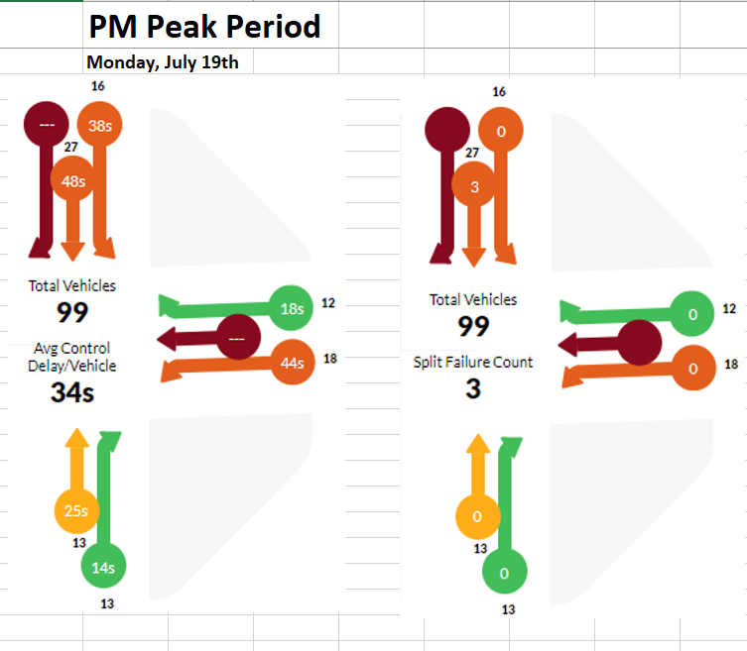
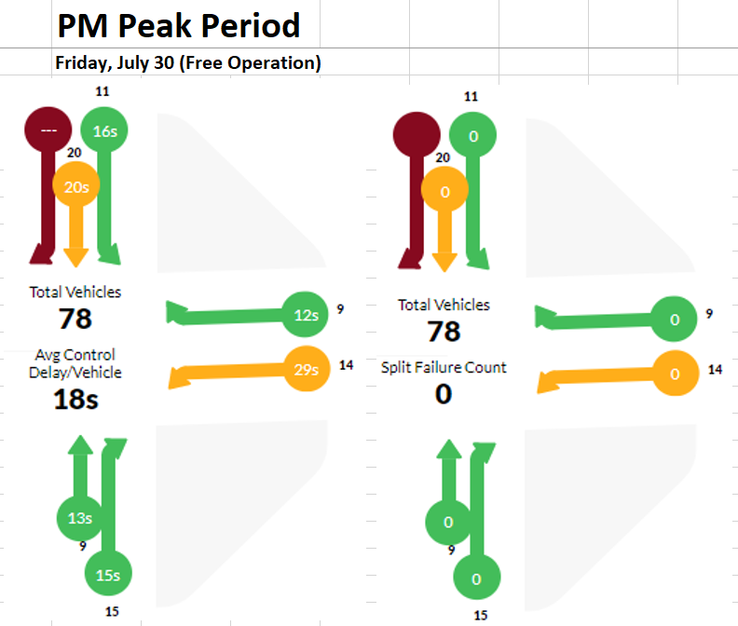
Use Case #3 Washington County Customer Complaint Response
Before Adjustment
After Adjustment
Notes:
Upon investigation a problem was apparent in the IQ dashboard. The SB movement experiences significant delay and split failures at the intersection. After adjusting the intersection and some parameters in the cabinet. The result was an improvement in both the control delay and a reduction in split failures during the PM peak period.

Slide 22
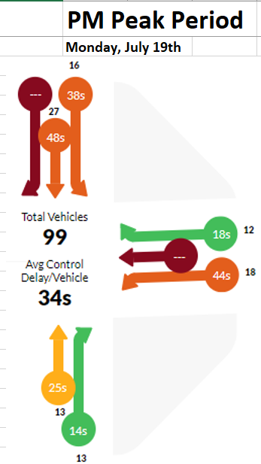
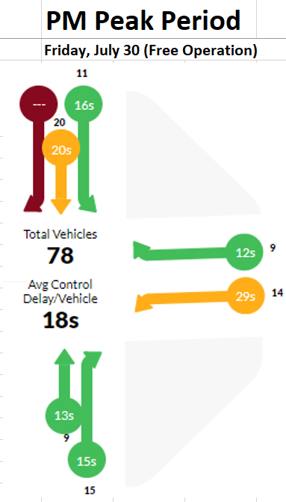

Washington County Energy Calculator Example
Before Adjustment
After Adjustment
Energy Savings
Using the energy metric calculator on the previous Washington County example, there would be a projected annual savings of:
Over 2,195 gallons of fuel saved
Over 22 tons of carbon dioxide equivalents

Slide 23
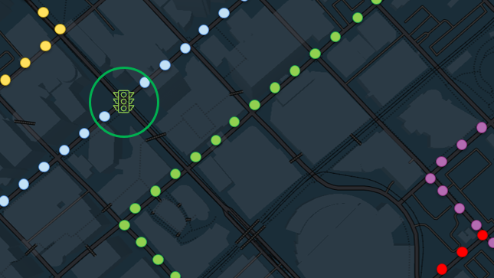
INRIX SIGNAL ANALYTICS
Thank you!
Steve Remias
Steve.Remias@inrix.com

